Slide 1
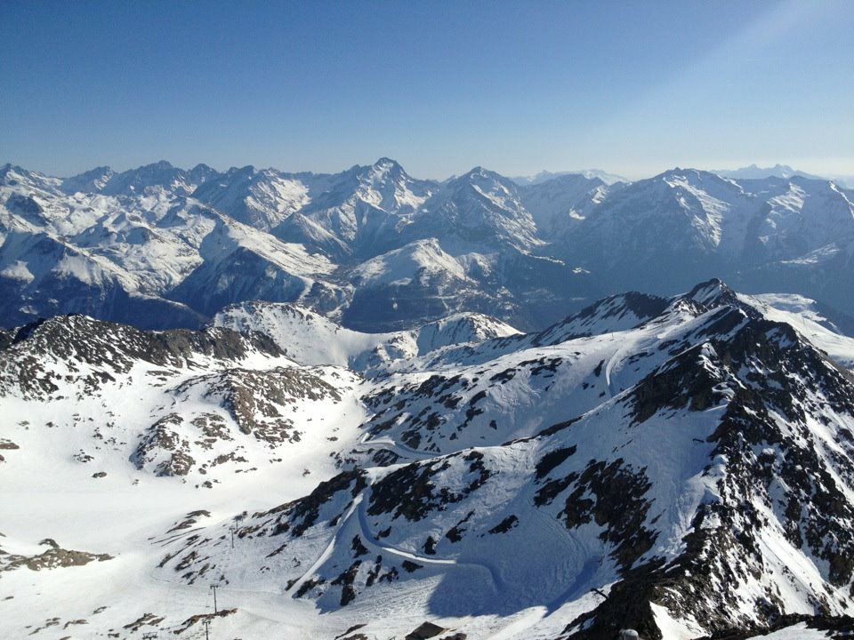

Ski 2026

Slide 2
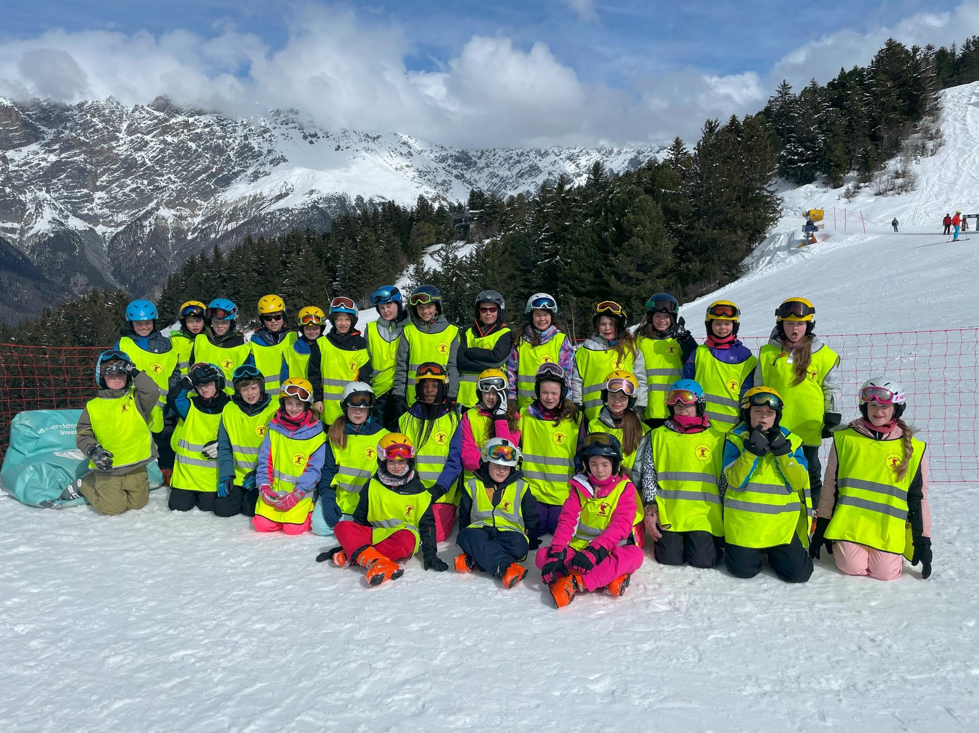

Slide 3
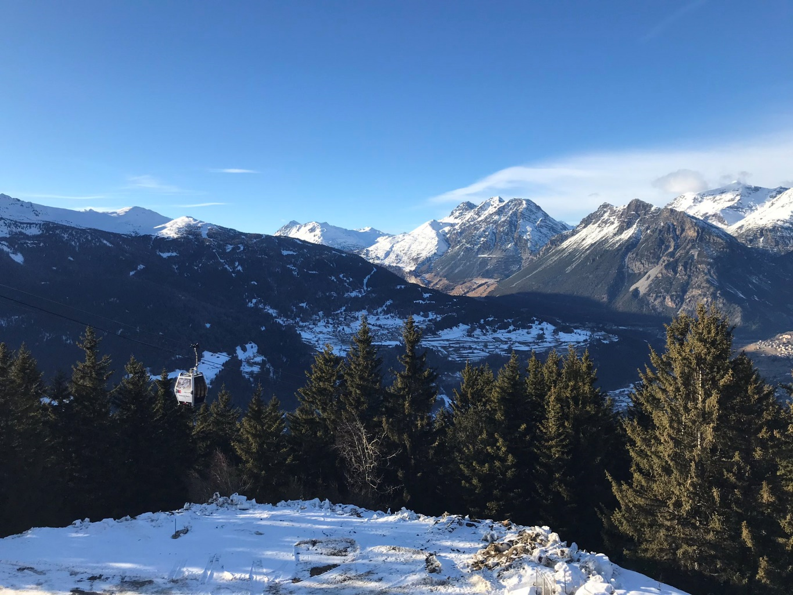
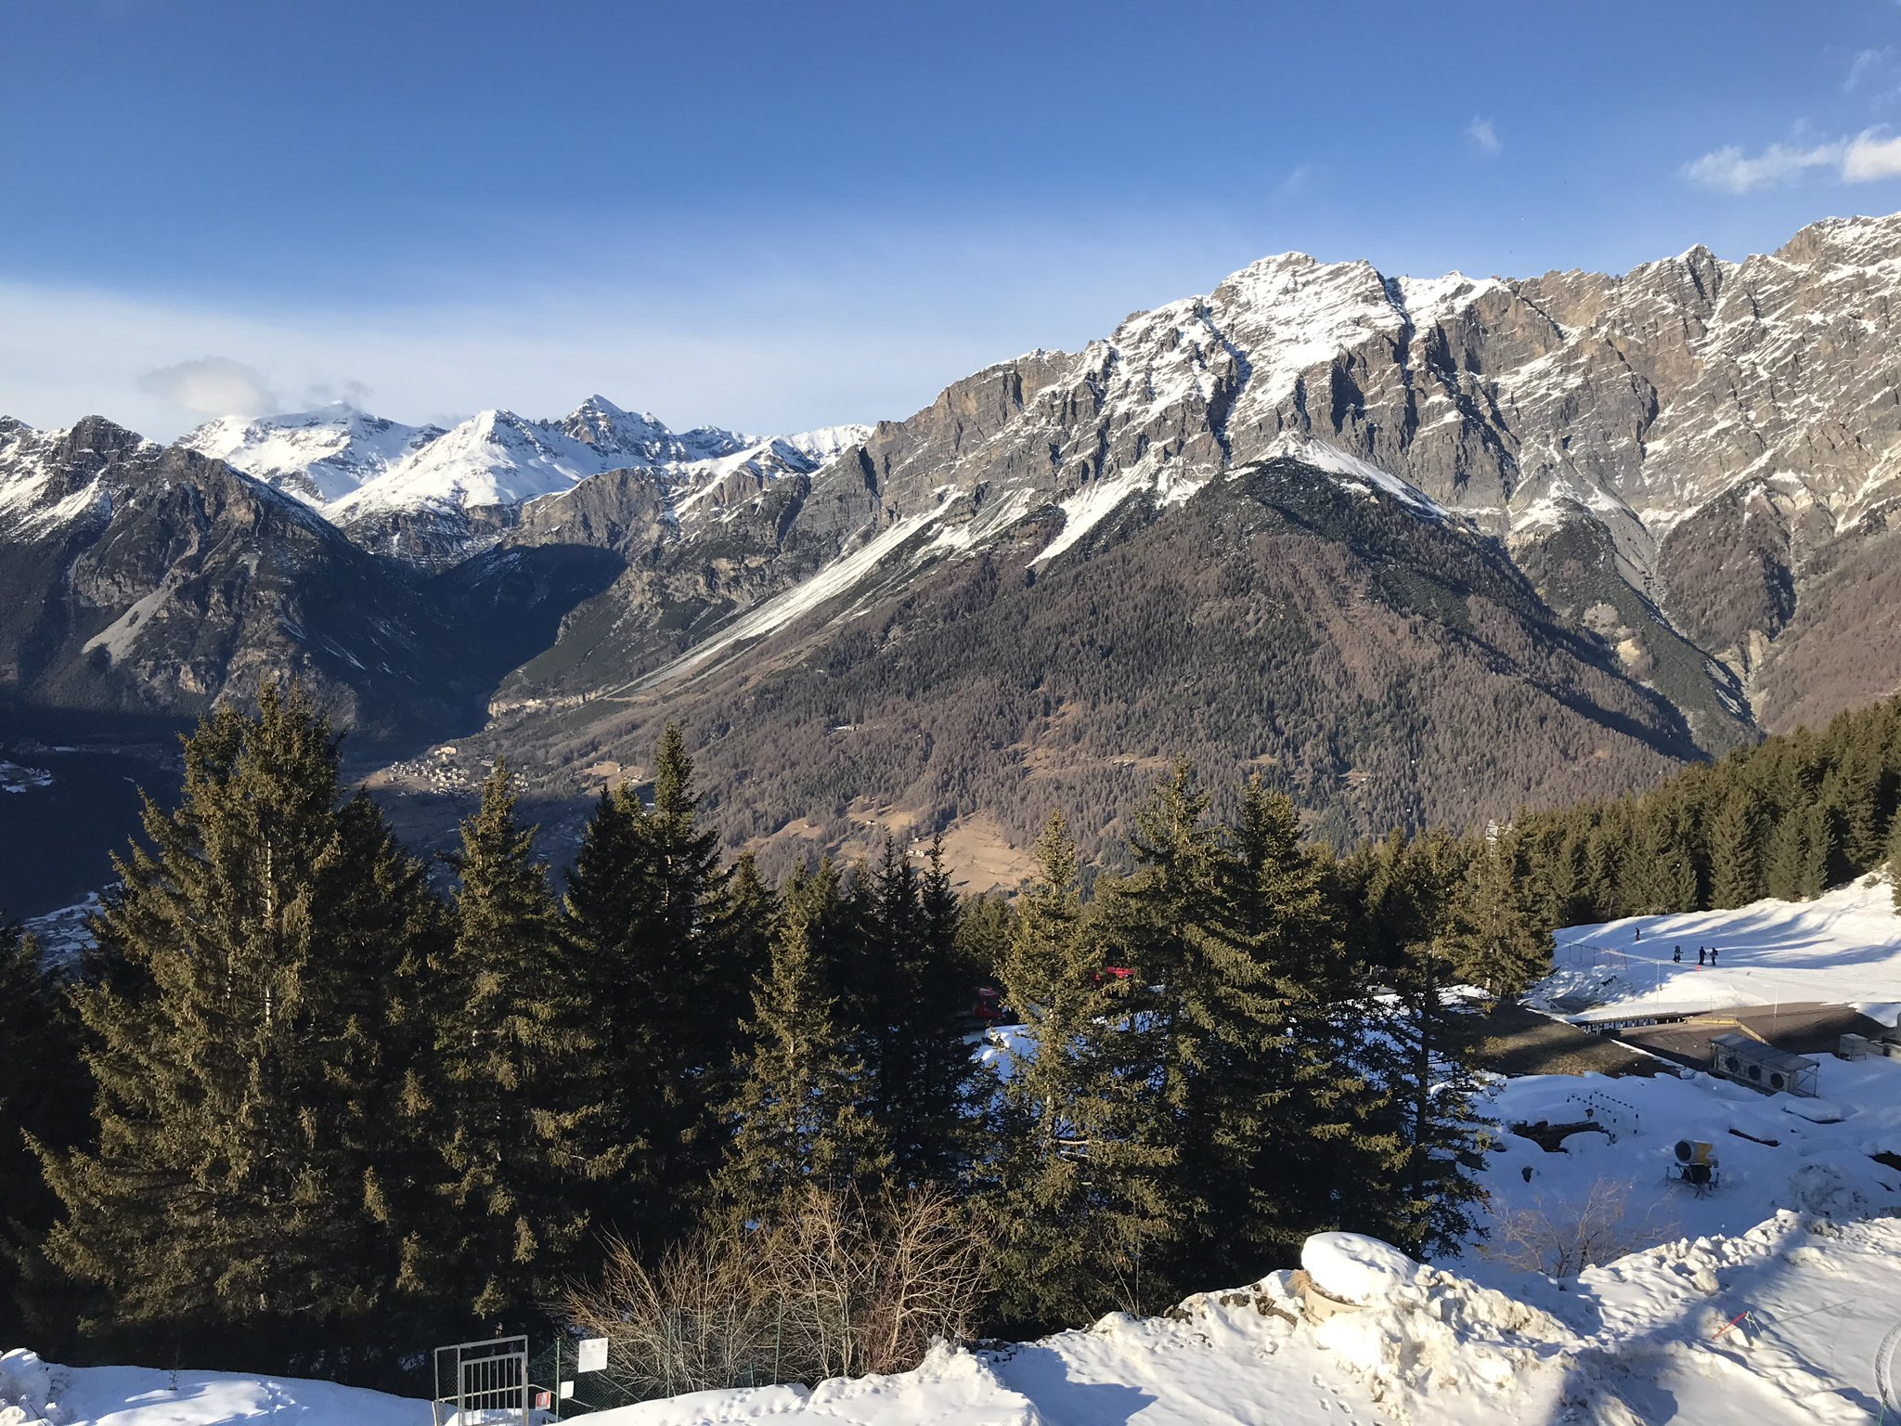
Bormio

Slide 4
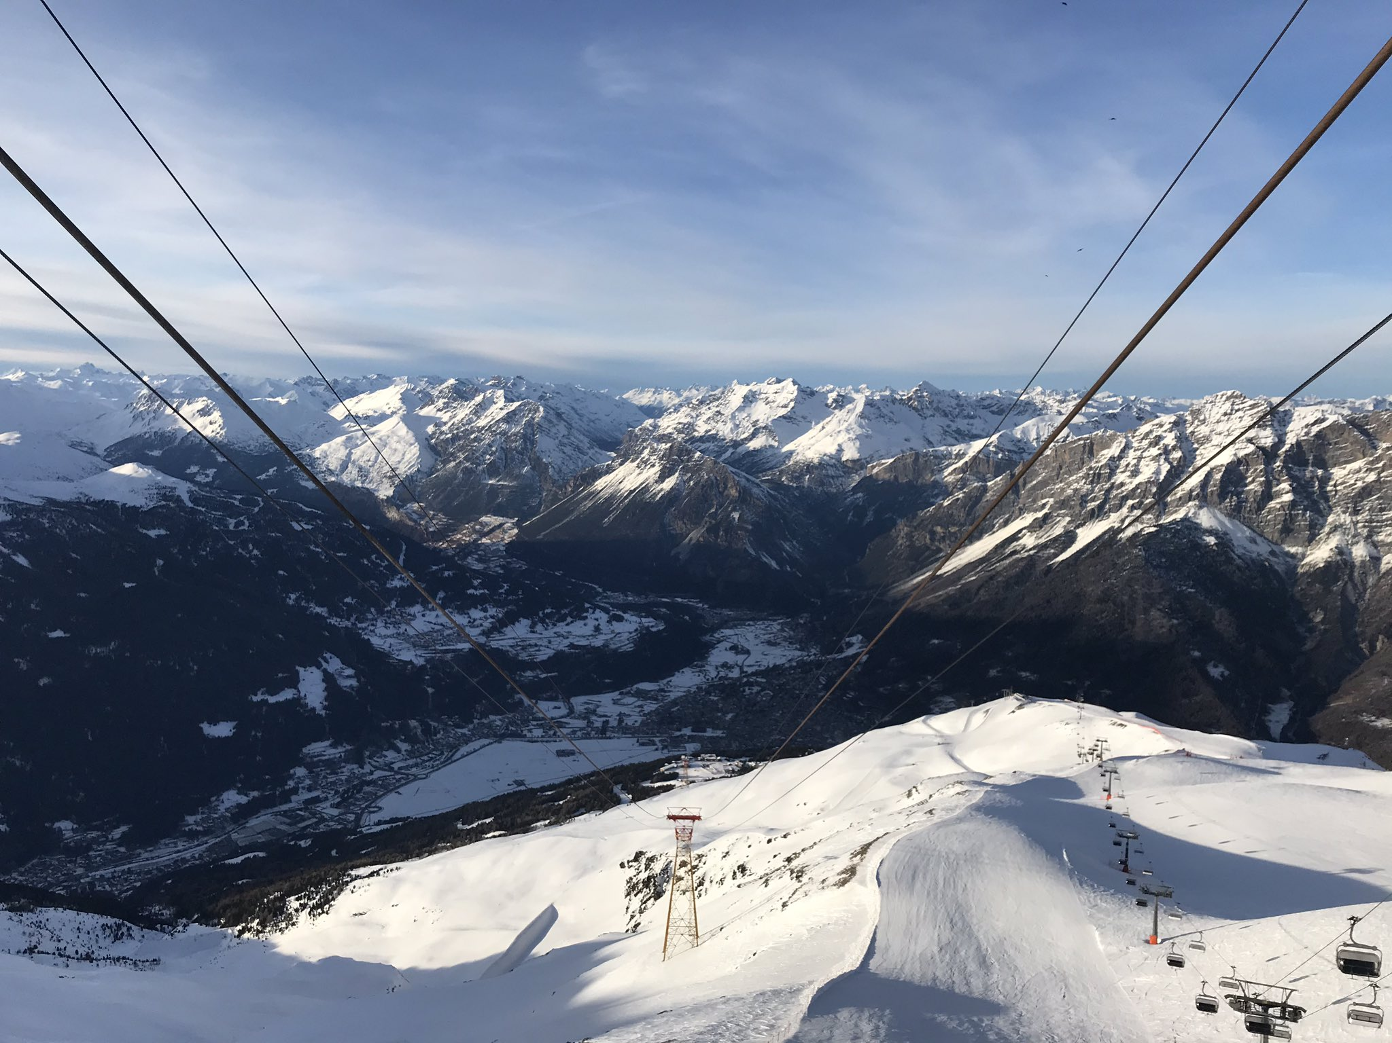

Slide 5

Ski 2026
The trip next year will, again, take place in Italy.
Dates – Sunday 18th January 2026 – Sunday 25th January 2026-
A WHOLE WEEK!
We will be staying in Hotel Girasole in Bormio, north West Italy.
The ski courses have been booked through the Ski Team 4 Ski Company, which is quality assured through the Learning Outside the Classroom scheme.
https://www.skiteam4.com/

Slide 6
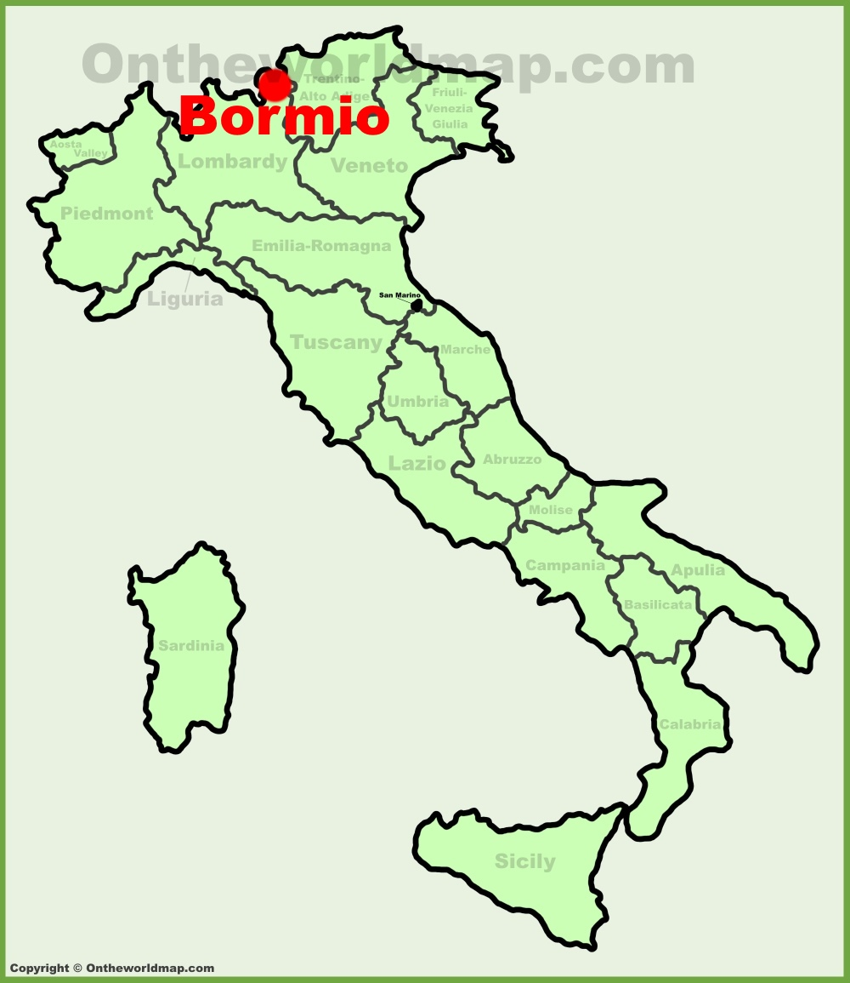

Slide 7
Bormio Webcam
https://www.bormioski.eu/en/webcam-bormio/

Slide 8
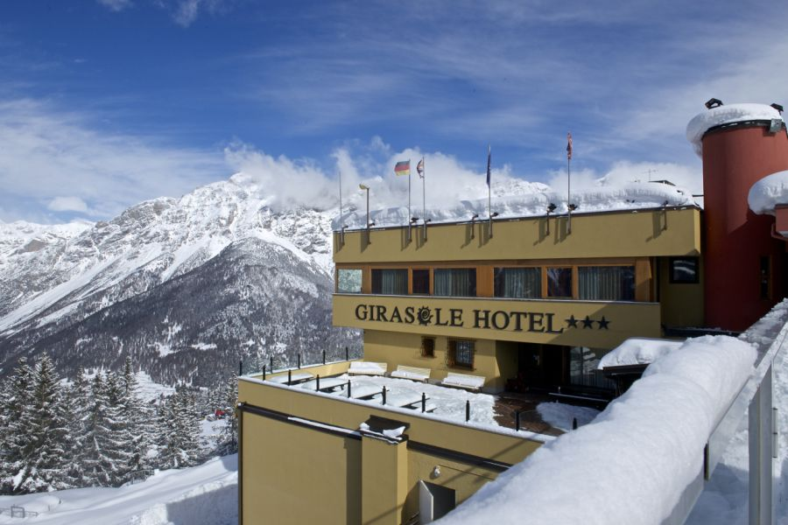
Hotel Girasole in Bormio

Slide 9
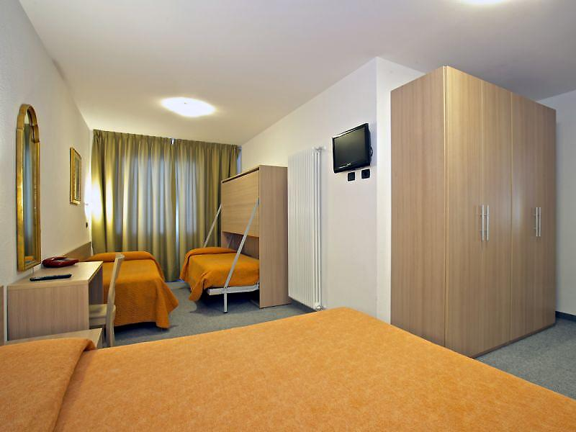

Slide 10
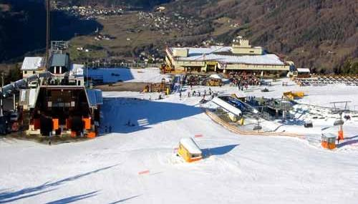

Slide 11
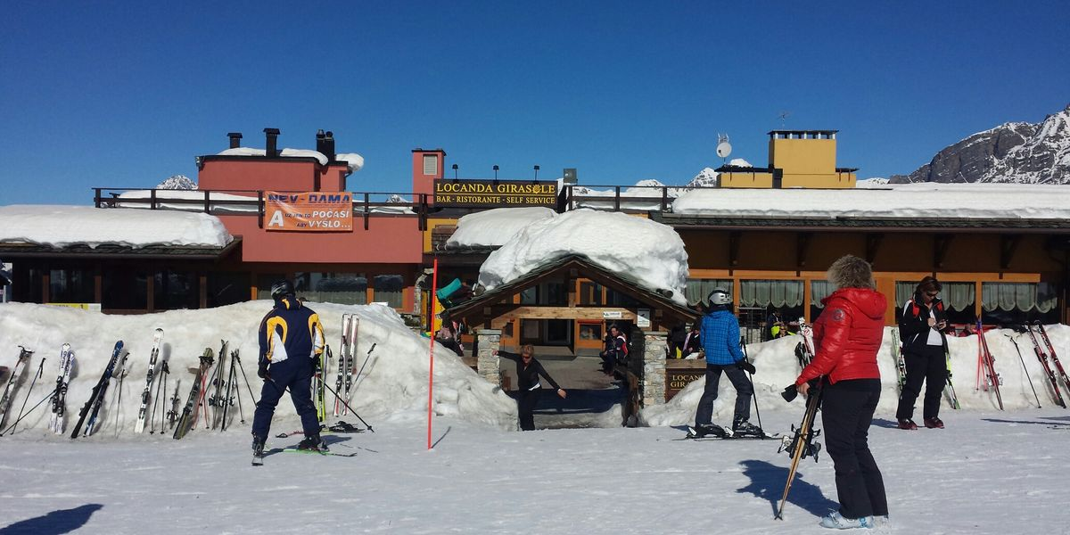

Slide 12
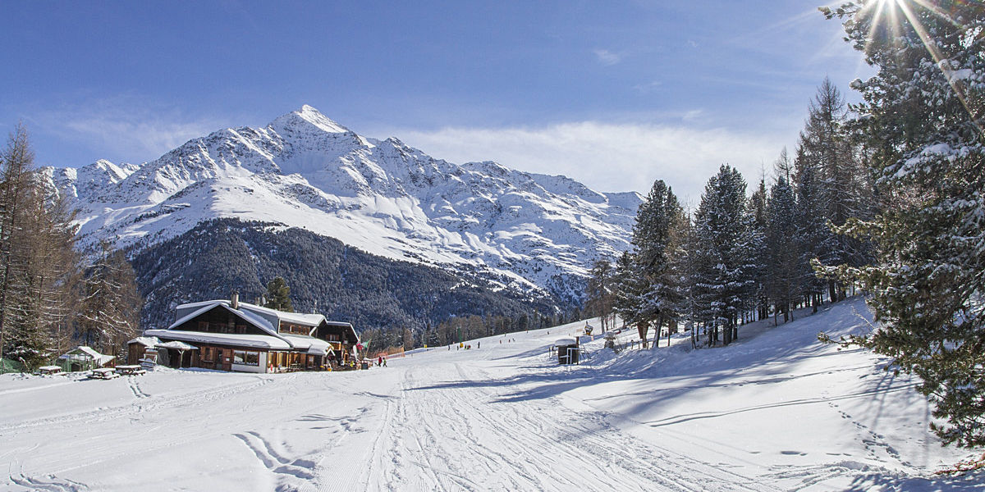

Slide 13
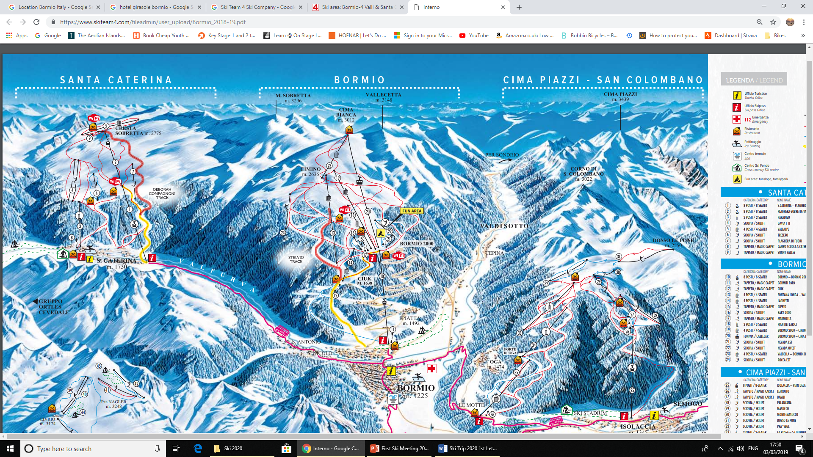

Slide 14
Skiing!
The courses are run by very experienced teaching staff, many of whom are serving or retired headteachers.
Staff members provide very high levels of pupil supervision. The courses also include a qualified nurse.
As with all our school trips we expect children who do take part to demonstrate a very high standard of behaviour.
The children will also need to have a good level of fitness and maturity.

Slide 15
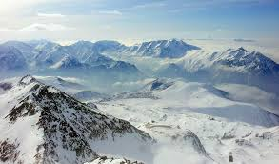
Ski 2025
Staff:
Mr White/ Mrs Crennell/ Mrs Fearnehough/ Miss Webster/ Mr Hathaway
Qualified ski instructors with each group – Everyday – All day!
Other staff from Liverpool Ski Association– Mr McKee
A Qualified Nurse – Nurse Mel offers valuable medical advice*.

Slide 16
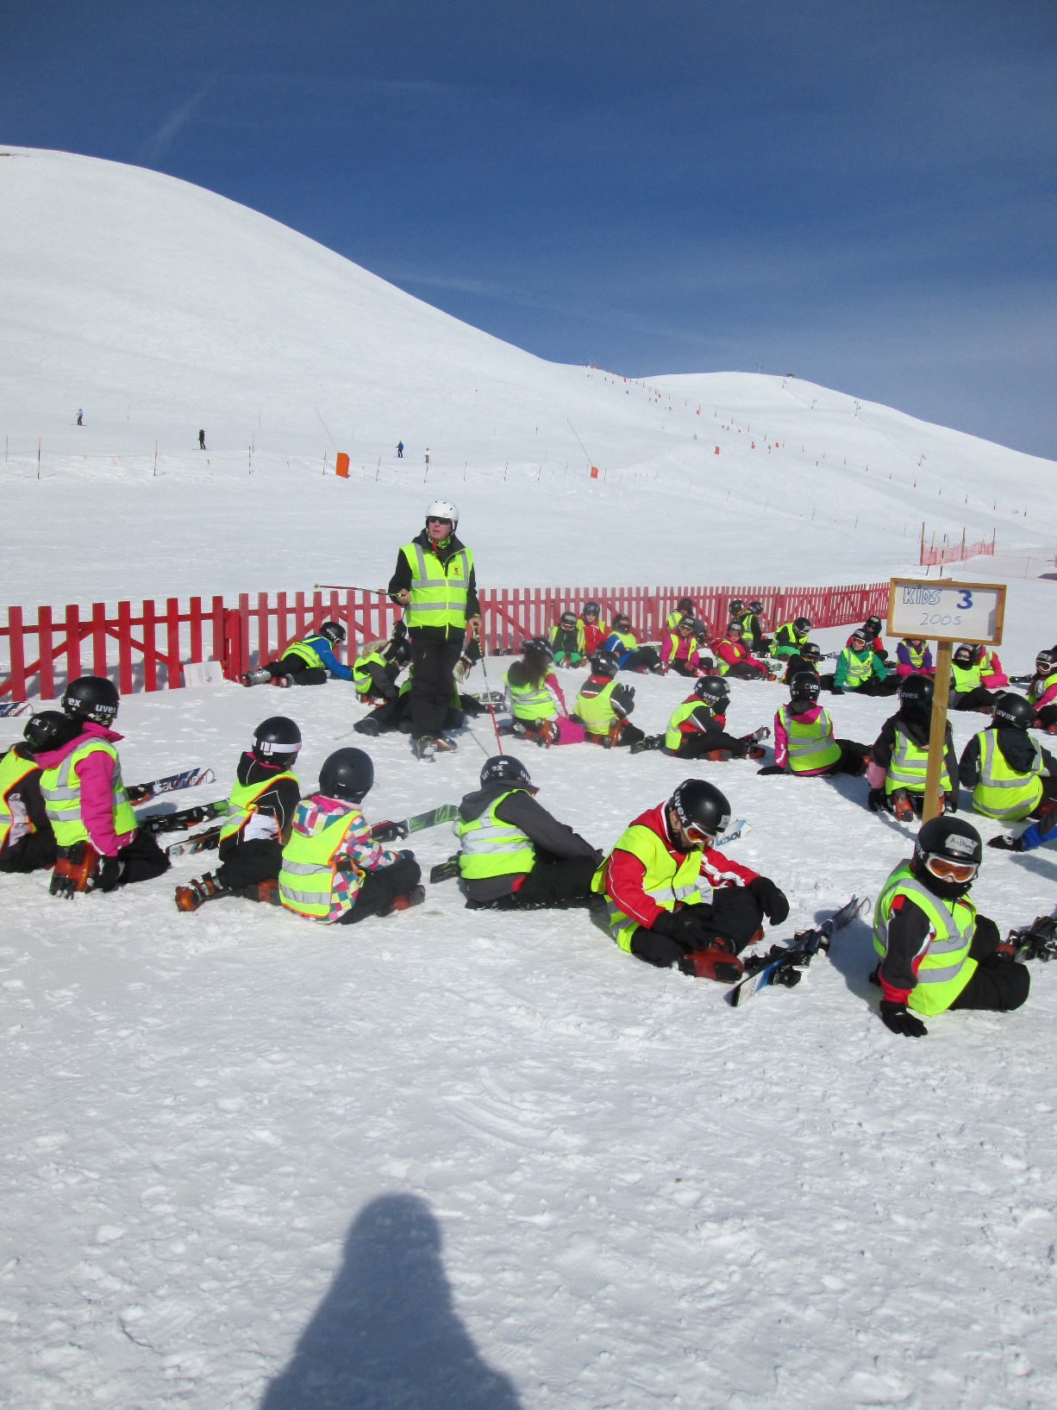
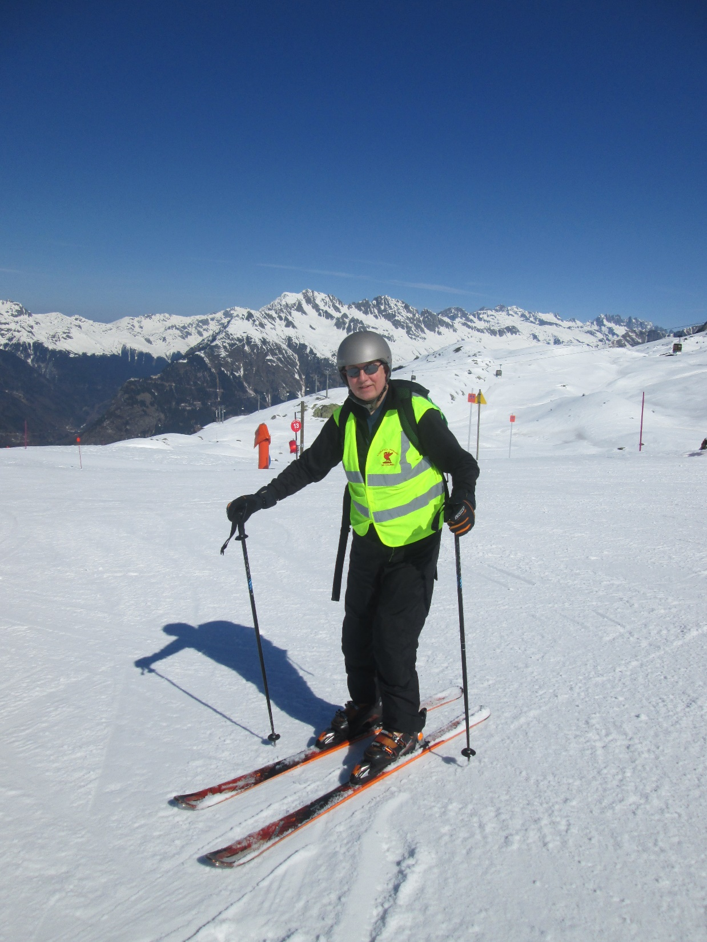
Mr McKee
Mr Tiffany

Slide 17
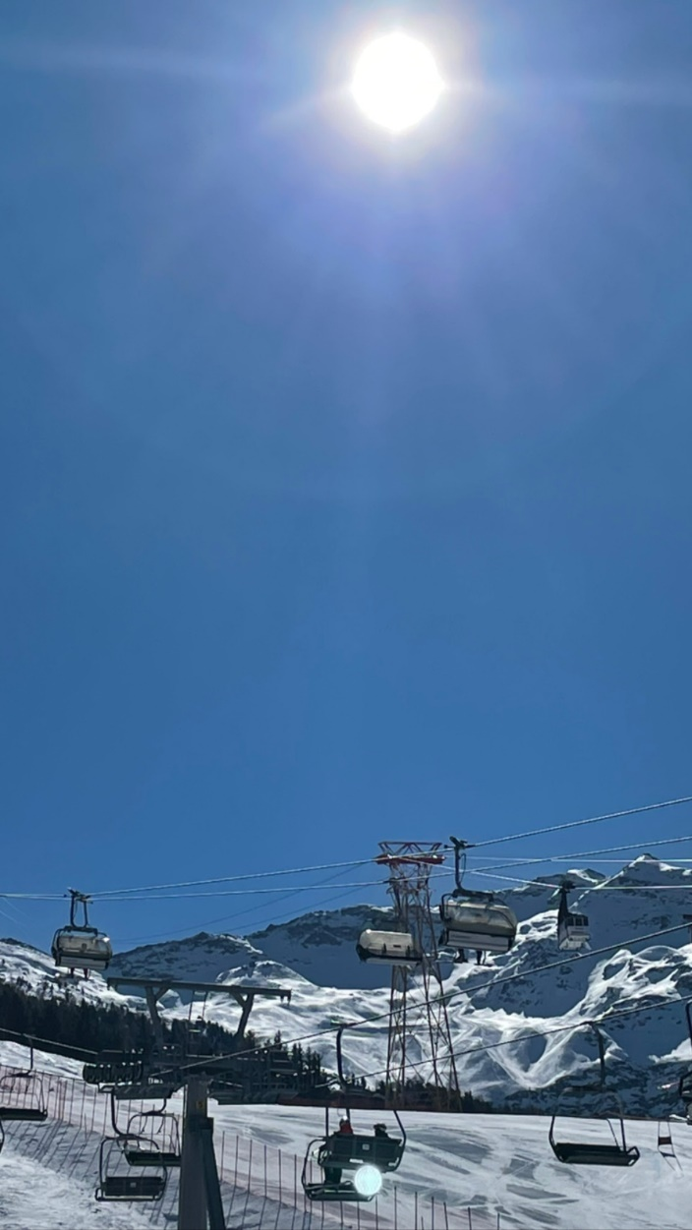

Ski 2026 – What happens next?

Slide 18
Pupil Handbook
Please read carefully with your child.
They will need to take this copy to resort with them!

Slide 19
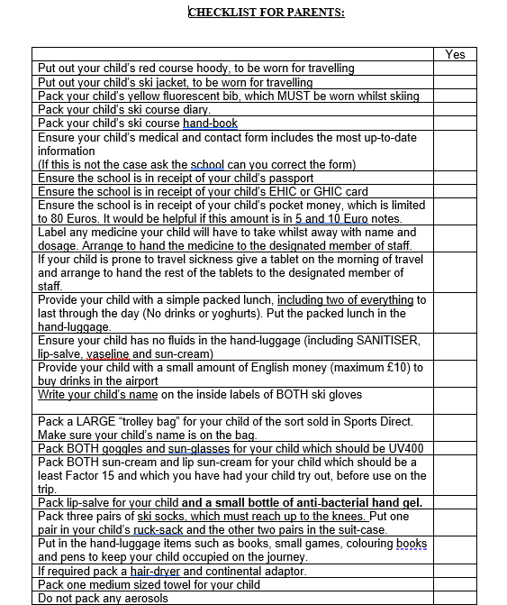
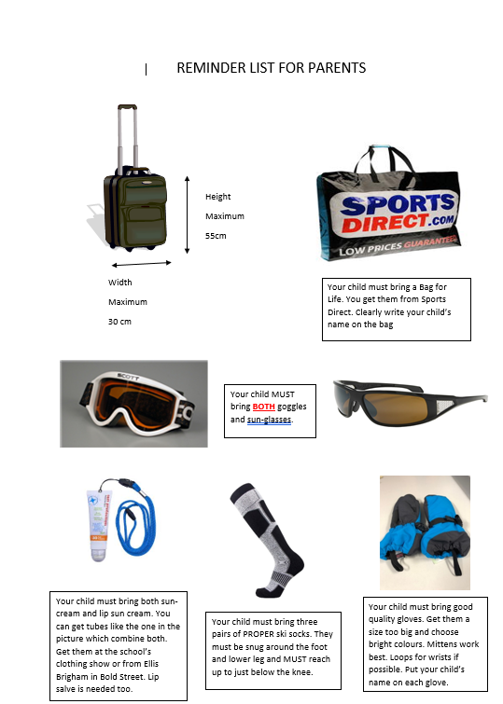

Slide 20
What your child will get from the Course!
An invaluable, life changing experience, learning to Ski and seeing a fantastic part of the world!
Both independence and the ability to work as a team!
Lessons in the best classroom they will EVER see.

