Slide 1
PGL Residential
20th – 22nd April

Slide 2
Staff
We have 5 members of staff attending the trip. We will also be guided by members of PGL staff throughout our stay.
Our staff:
Miss Preston
Miss McNelis
Mr Hathaway
Miss Connolly
Mrs Wilson

Slide 3
Safety
Before departure, our trip will be fully risk assessed and authorized by the LA.
PGL operate in line with their Code of Practice (www.pgl.co.uk/cop) which outlines the following:
Sample risk assessments
Staff-to-pupil ratios
Operating procedures
Staff vetting & training
Site security
First Aid procedures
Emergency procedures

Slide 4
Itinerary – Monday 20th April
Children should arrive at school at normal time.
Suitcases can be dropped off at the main hall and any medication must be given to Miss Preston (labelled clearly).
We expect to depart school at approximately 10am.
Any travel sickness medication will need to be taken with this departure time in mind.
Children should travel in comfortable clothes that they can wear for activities. They will need a water bottle.

Slide 5
Arrival at PGL
We expect to arrive at Boreatton Park between 11:30am – 12pm.
Our lunch will be provided by PGL
Afterwards, we will be given a site tour, have a chance to settle into our accommodation and experience our first activity.
After our evening meal, we have our first evening activity altogether.

Slide 6
A typical day at PGL
A typical day includes breakfast, lunch and dinner.
2-3 activities throughout the morning/afternoon in groups
End the day with an evening activity altogether

Slide 7
Arrival back at school
We will leave PGL at approximately 2pm.
We expect to arrive back at school at around 3:30pm. Children can be collected from Speke Road at the top of Watergate Lane.
Travel sickness medication needs to be provided for the return journey – a medication form will need to be filled in for this.

Slide 8
Medication
All medication should be clearly marked and handed to Miss Preston on arrival at school.
Copies of medical forms will be kept with Miss Preston and the school office.
PGL staff will be fully informed about our groups medical/ dietary requirements prior to our visit.
Asthmatic children should bring their inhalers. These will be given to MW staff to look after during activities.

Slide 9
What should my child bring?
Kit lists available to take home
What shouldn’t they bring?
Mobile phones
Expensive cameras
Electronic games
Expensive or sentimental jewellery or toys
Favourite clothing or shoes
White clothes

Slide 10
Groups
Children will be taken to activities in groups of 15 (approx) and will be accompanied by staff from Much Woolton and PGL.
Children will be able to give their preference for groups/rooms.

Slide 11
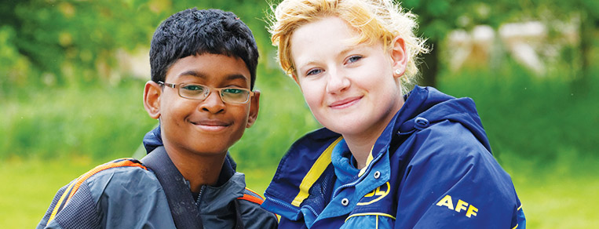





Welcome to PGL
The UK’s largest provider of outdoor education for young people
Over 55 years’ experience
Fully risk assessed
LOtC Quality Badge holder
Founding member of BAPA
ABTA bonded
Notes:
PGL provides a wide range of inspiring residential adventure and educational courses for more than 5,000 groups every year
All PGL centres and activities are risk assessed to comply with legal requirements and best practice. Risk assessments are available by request and on the PGL website
Centres are subject to the Adventure Activities Licensing Authority regulations (AALA) where appropriate
ABTA (Association of British Travel Agents) bonded means your money is protected
BAPA – British Activity Providers Association. Responsible for establishing operating guidelines for the activity holiday industry
Through the Learning Outside the Classroom Quality Badge Programme you can be confident that recognised providers fulfil all the necessary criteria as laid down by the DfE, thereby better enabling Party Leaders to manage visits safely, efficiently and beneficially

Slide 12
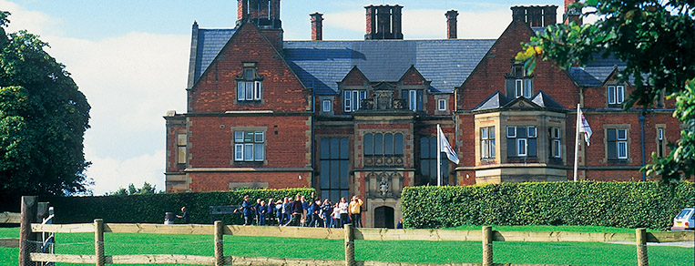

LEARNING OUTSIDE
Boreatton Park - Shropshire
26 fantastic adventure activities to choose from
250 acres of beautiful grounds
Lakes and river for watersports
Explore the 360 Virtual Tour www.pgl.co.uk/boreatton360 to see inside the centre and view activity information and videos

Slide 13
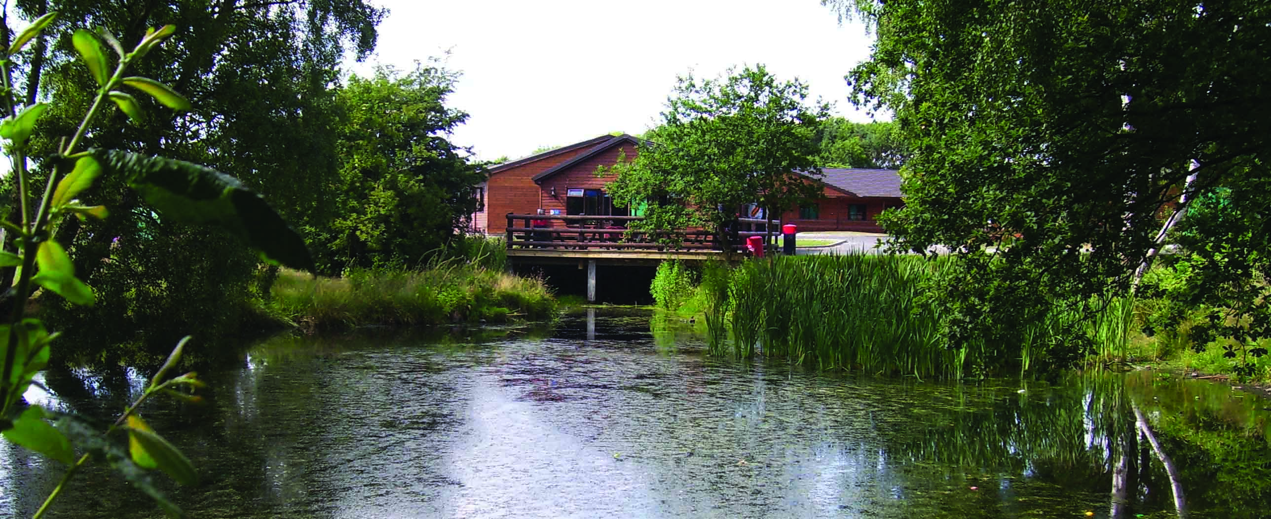
Facilities
250 acres of grounds to enjoy
Lakes and river for watersports
Sports and indoor activity hall
Football pitches & playing fields
Netball Courts
On-site adventure activities
Disco
Shop
Classrooms / Meeting rooms
Notes:
The centre can accommodate 310 guests at a time in two separate purpose built accommodation blocks.
Pupils are accommodated in 4-6 bedded rooms, all en suite with shower and toilet facilities
Teachers are usually accommodated in twin rooms with en suite and hot drink facilities
All rooms are lockable with card key (party leader given master key)
All exterior doors and gates are locked at night
A PGL staff member is available on duty throughout the night (contactable by phone)
The extensive facilities (other than activity bases) are available to your group during free time
The outdoor heated swimming pool is usually available May – Sept. Sessions are booked in advance with the Tour Leader on arrival at the centre

Slide 14
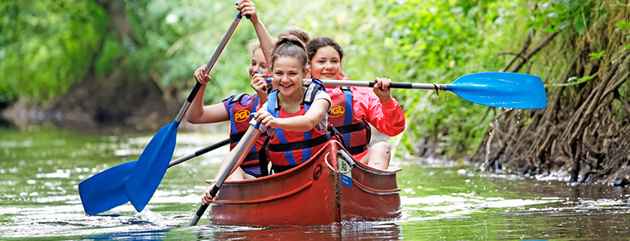
Adventure activities
Abseiling
Aeroball
Archery
Canoeing
Challenge Course
Climbing
Eco Trail
Fencing
Giant Swing
High Ropes Course
Jacob’s Ladder
Kayaking
Low Level Ropes Course
Orienteering
Problem Solving
Quad Biking
Raft Building
Rifle Shooting
Sensory Trail
Sports and Team Games
Survivor
Trapeze
Vertical Challenge
Zip Wire
Notes:
The activities shown offer individual as well as team challenges
Activities are designed to encourage new skills and develop existing ones
Specific activities can be requested (though not guaranteed) and the programme is discussed on arrival at the centre

Slide 15
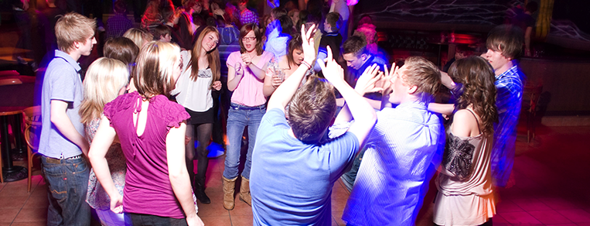
Evening entertainment
50/50
Aeroball
Ambush
Campfire
Capture the Flag
Cluedo
Disco
Passport to the World
Robot Wars
Snapchat Challenge
Splash
Swim
Team Challenge

Slide 16
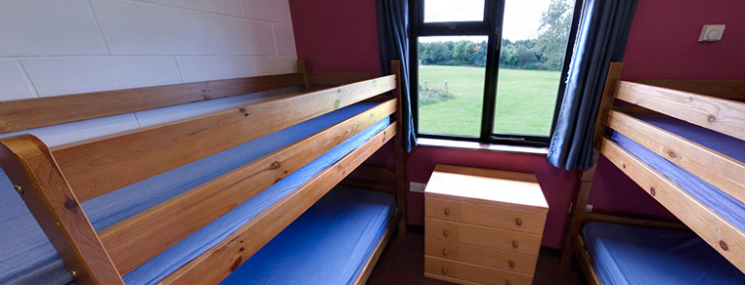
Accommodation
Mansion House – rooms sleep 8-14 with nearby facilities
Lodges – en suite rooms sleep 4-6
Frame tents on solid bases – sleep 4
Accommodation for Boreatton Park can be viewed in the 360 virtual tour: www.pgl.co.uk/boreatton360
Notes:
The centre can accommodate 916 guests at a time with accommodation in the mansion house, lodges or tents in the summer
Teachers are usually accommodated in twin rooms with en suite and hot drink facilities
All rooms are lockable (party leader given master key)
All exterior doors and gates are locked at night but can be opened from the inside in an emergency without the need for unlocking
A PGL staff member is available on duty throughout the night (contactable by phone)
The extensive facilities (other than activity bases) are available to your group during free time

Slide 17
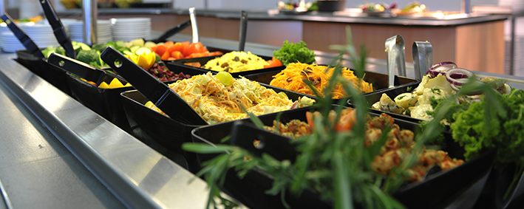
Catering and dietary needs
3 nutritious, balanced meals per day
Self-service salad bar
Vegetarian option
Special diets catered for by prior arrangement
Sample menus available online: www.pgl.co.uk
Notes:
We continually invest in healthy menus with freshly cooked ingredients obtained from fully traceable audited suppliers
Processed food is avoided and meals meet Local Authority guidelines
There will be hot and cold options available at every meal
At lunch and dinner the buffet includes a salad bar and mixed fruit basket plus hot and cold drinks
Our caterers can deal with most dietary requirements but please ensure the party leader is aware of any dietary requirements well in advance
More food is always available if required

