Slide 1

Year 6 Residential Visit
Tawd Vale Adventure Centre
Parent briefing meeting
Notes:
Welcome parents and carers. Explain that the meeting will cover the purpose of the residential, activities, accommodation, safety, kit, medical information and what school needs before the trip.

Slide 2
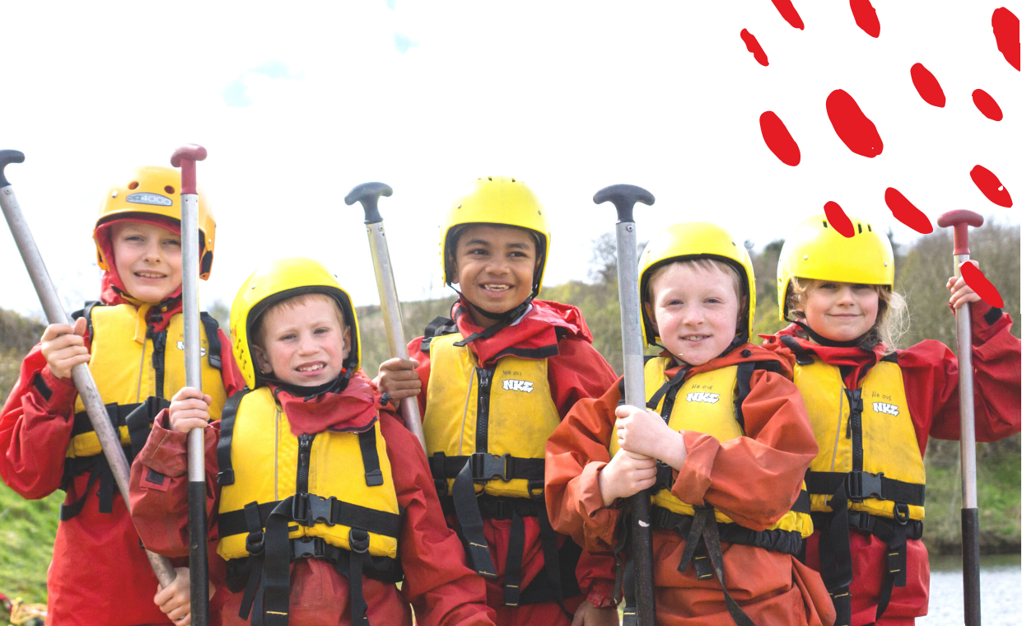
Meeting aims
Parent briefing
What we will cover today
1
Purpose of the residential
Why the trip supports transition and independence
2
The site and accommodation
Where pupils will stay and what the camp looks like
3
Activities and daily routine
What pupils are likely to do each day
4
Safety and supervision
How staff and instructors will manage pupils
5
Kit, medical needs and actions
What parents need to return or prepare
Please ask general questions at the end. Individual concerns can be discussed privately afterwards.
Year 6 Tawd Vale residential parent briefing
Notes:
Set a calm and reassuring tone. Let parents know that the aim is clarity and confidence, not information overload.

Slide 3
Why we go on residential
Learning beyond the classroom
A key part of the Year 6 journey
The residential gives pupils a safe opportunity to grow in confidence before secondary school.
1
Independence
2
Resilience
3
Teamwork
Managing kit, routines, sleep, meals and personal organisation away from home.
Trying challenging activities, overcoming nerves and learning that mistakes are part of growth.
Communicating, encouraging others and working together during outdoor challenges.
The aim is for pupils to return proud of what they have achieved and ready for the next step.
Year 6 Tawd Vale residential parent briefing
Notes:
Emphasise that this is not just a reward trip. It is a chance to practise independence, communication, responsibility and problem solving before pupils move to secondary school.

Slide 4
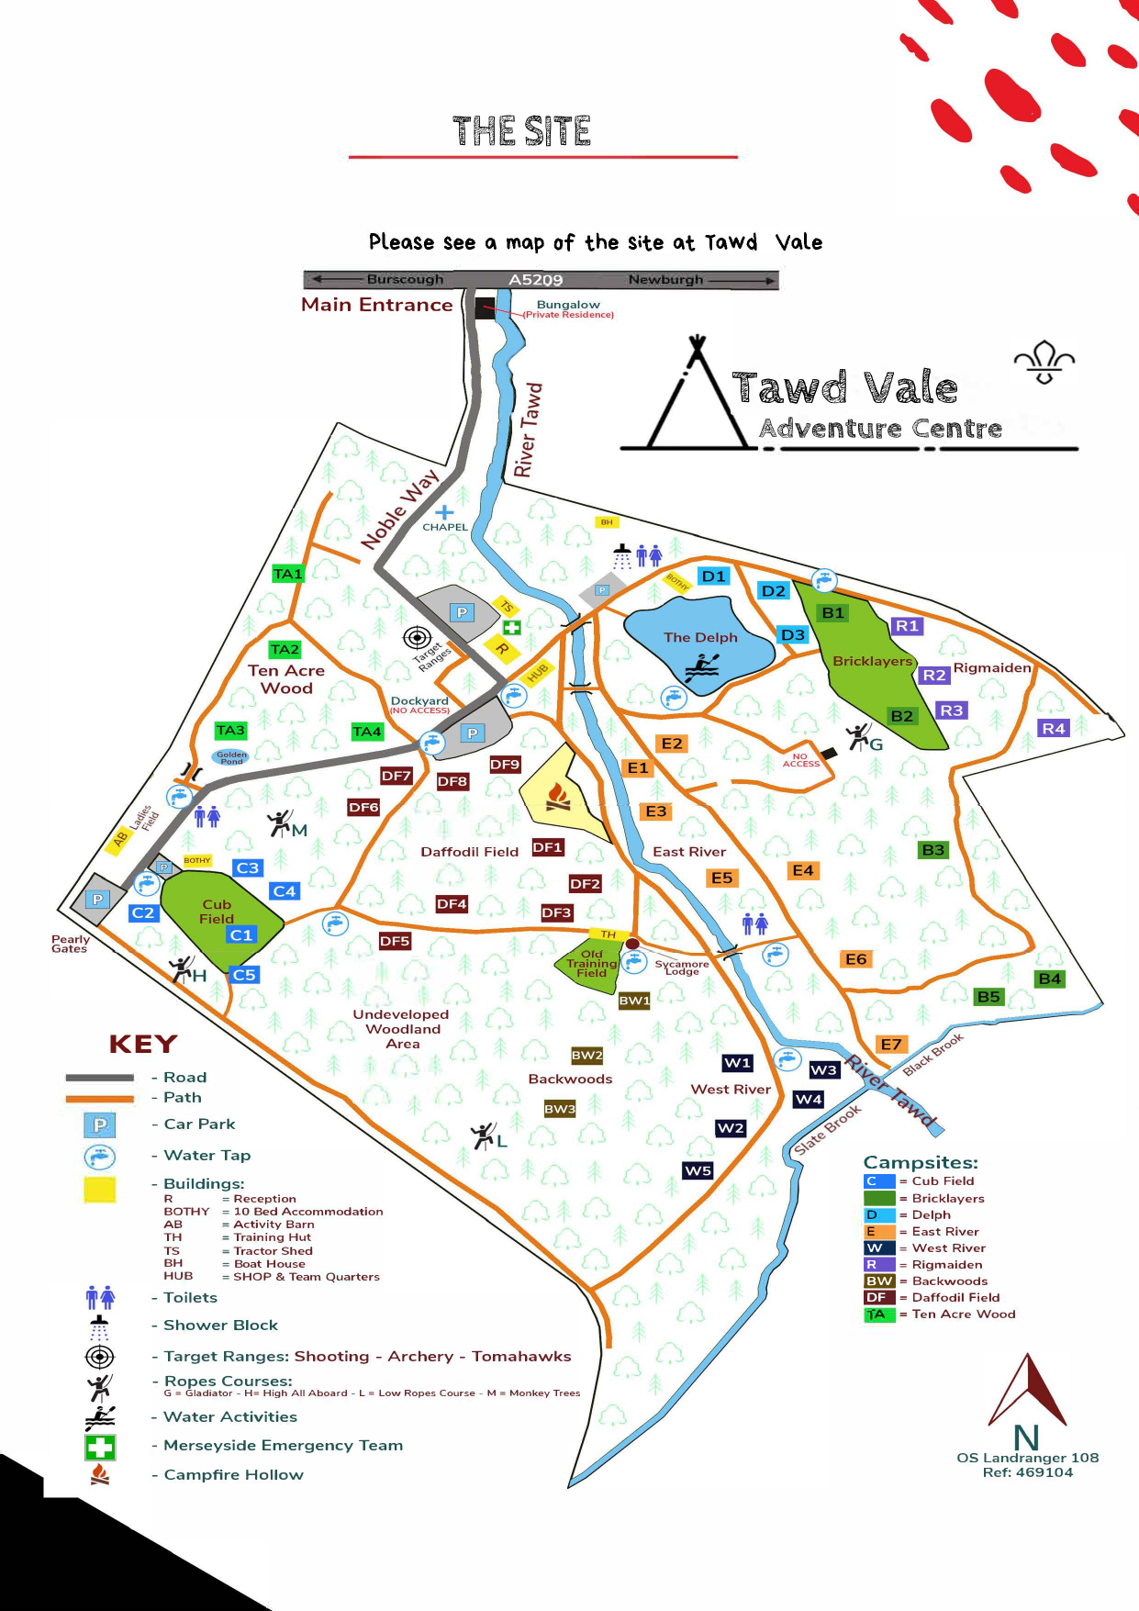
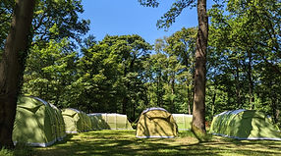
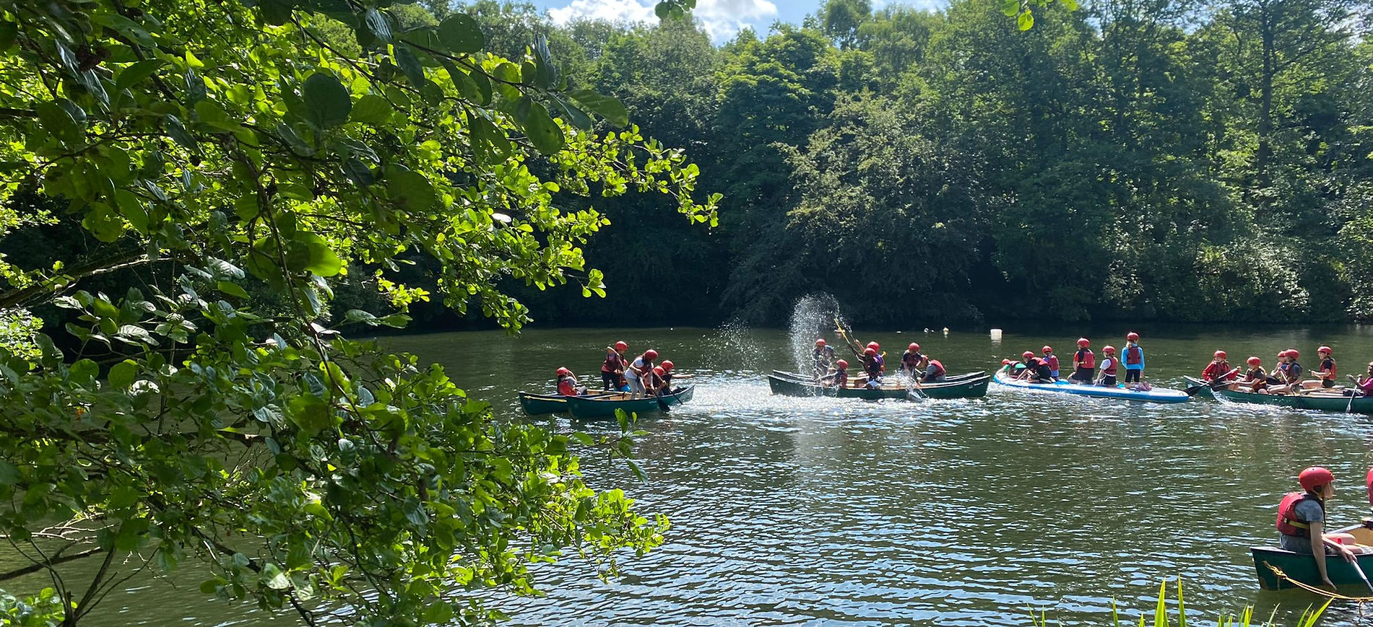
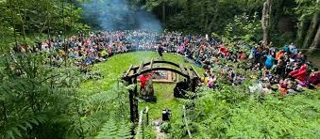
Trip overview
Key details
Where we are going
📍
Venue
Tawd Vale Adventure Centre, Lowry Hill Camp, Lathom, West Lancashire, L40 5UL.
🏕
Provider
High Adventure Outdoor Education Centre. The camp team includes a manager, assistant manager, instructors, cooks and domestic staff.
📅
Dates
6 to 8 July 2026. Final departure and return times will be confirmed by school.
The site includes activity areas, fields, woodland, water areas, toilets, showers, dining areas and campfire spaces.
Map reproduced from the Tawd Vale Summer Camp brochure
Notes:
Talk parents through the map. Explain that pupils will be given clear boundaries on arrival and will move around the site in supervised groups. Mention that the site is an outdoor camp with different activity areas rather than one building.

Slide 5
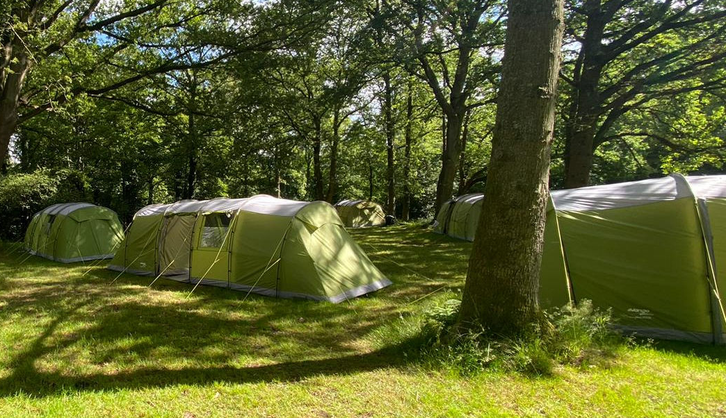
Accommodation
Tented residential
What pupils will sleep in
This is a camping residential. Pupils will stay in tents, with staff tents nearby.
✓
Tents set up by High Adventure
✓
Sleeping bag and pillow needed
The camp team puts up the tents before pupils arrive.
The centre provides a thick camp mat.
✓
Spacious tent groups
✓
Toilets and showers on site
The brochure states that one 8 person tent is usually used for every six pupils.
Dedicated toilet and shower facilities are available.
Please do not send valuable items, expensive electronics or jewellery.
Year 6 Tawd Vale residential parent briefing
Notes:
Be clear that pupils are camping. Reassure parents that staff tents will be nearby and pupils will know how to get help overnight. Explain that tent groupings will consider friendships but will be decided by staff based on wellbeing, safety and supervision.

Slide 6
Activities
What pupils may take part in
A busy outdoor programme
Activities are designed to build confidence, teamwork, communication and resilience.
High ropes
Water sports
Archery
Bushcraft
Aerial challenge course with safety equipment
Canoe rafts and water based teamwork
Target skills and coaching games
Shelter building, camp craft and fire lighting
Orienteering
Nightline
Team building
Campfire and evening activities
Navigation and exploratory challenges
Trust, communication and sensory teamwork
Practical problem solving tasks
Shared experiences and group challenges
Pupils are encouraged and supported. They are not forced into something they are not ready for.
Year 6 Tawd Vale residential parent briefing
Notes:
Explain that the exact programme may vary, but these are the activities listed by High Adventure for the summer camp. Stress that instructors lead the activity safety and school staff support pupils emotionally and behaviourally.

Slide 7
Daily routine
Indicative timings
A structured day at camp
Timings may be adjusted by High Adventure to suit the group and conditions.
8:00 am
9:15 am
12:30 pm
1:30 pm
Breakfast
Morning activity meeting
Lunch
Afternoon activities
Pupils eat and make their packed lunch
Groups line up and meet instructors
School staff supervise the group
Instructors take charge of activity sessions
4:45 pm
5:45 pm
7:00 pm
8:30 pm onwards
Activities finish
Evening meal
Evening activity
Downtime and bedtime
Pupils return to school staff
Orderly dining and announcements
Campfire, quiz or group challenge
School staff supervise pupils overnight
Year 6 Tawd Vale residential parent briefing
Notes:
Use this to explain that the days are full and structured. Emphasise that lunch, downtime, meals and overnight are supervised by school staff. Activity sessions are led by High Adventure instructors.

Slide 8
Food and drink
Meals at camp
What pupils will eat
Pupils will be well fed, but they need to bring a mug, lunch box and water bottle.
☀
Breakfast
🥪
Packed lunch
🍽
Evening meal
Cereal, bread and butter with jam, fresh fruit, fruit juice and hot options such as baked beans or porridge.
Pupils make their own packed lunch each morning during breakfast. Staff help organise this.
Freshly prepared meals are provided, with a dessert. Sample meals include chilli, curry, pasta and fajitas.
Dietary needs and allergies must be shared in advance on the medical form.
This includes vegetarian requirements, food allergies, intolerances and any worries around eating.
Year 6 Tawd Vale residential parent briefing
Notes:
Reinforce the importance of the mug, lunch box and water bottle because pupils need them at meal times. Ask parents to make sure all dietary needs are written clearly, even if school already knows about them.

Slide 9
Kit list
What to bring
Outdoor clothing, practical kit and spare clothes
Clothing and bedding
Equipment and essentials
Sleeping bag and pillow
Two pairs of outdoor footwear
Trackies or combat trousers, not jeans
T shirts and warm layers
Warm jacket and waterproof jacket
Underwear and socks
Small towel and large towel
Toiletries
Plastic bags for wet clothes
Torch and spare batteries
Small rucksack or daypack
Sun protection
Wellies or waterproof boots
Mug, water bottle and lunch box
There is a tuck-shop on site. Children can bring £5 in a labelled envelope
to be handed to a member of staff on the Monday morning.
No more than £5 per child please!
Label everything. Clothes should be suitable for mud, rain and outdoor activity.
Year 6 Tawd Vale residential parent briefing
Notes:
Mention that the kit list says no item is really optional. The key message is warm, dry and comfortable. Encourage parents to avoid jeans because they become uncomfortable when wet and dry slowly.

Slide 10
What not to bring
Valuables and unsuitable items
Please keep it practical
The centre cannot take responsibility for personal items and there are no lockers for pupils.
✕
No expensive electronics
✕
No jewellery or valuables
✕
No new or precious clothing
Phones, tablets, games devices and expensive cameras should not be brought.
Jewellery can be lost or damaged and is not suitable for outdoor activities.
Clothes may get wet, muddy or smoky from outdoor activities and campfire.
Practical rule: if it would be upsetting to lose it, damage it or get it muddy, leave it at home.
Year 6 Tawd Vale residential parent briefing
Notes:
Be firm but friendly. Explain that pupils will be busy and the lack of phones often helps them settle better. School will contact parents directly if needed.

Slide 11
Medical information
Forms and medication
Accurate information keeps pupils safe
1
Medical form
Return it as soon as possible and include all relevant information.
2
Medication
Medication must be clearly labelled and handed to school staff.
3
Dosage instructions
Written instructions are needed for timings and doses.
4
Emergency medication
Inhalers and emergency medication will be accessible when needed.
5
Dietary needs
Allergies, intolerances and vegetarian requirements must be shared in advance.
6
Emergency contacts
Please check that school has the correct contact details.
Please tell school about anything that may affect sleep, eating, anxiety, travel sickness or participation.
Year 6 Tawd Vale residential parent briefing
Notes:
Ask parents not to assume that school already knows everything. The residential requires the most current information. Invite parents with sensitive information to speak privately after the meeting.

Slide 12
Supervision and safety
Who is responsible for what
A shared approach to safety
🧗
High Adventure instructors
👥
School staff
✓
Pupils
Lead activity sessions, provide safety briefings, check equipment and dynamically risk assess activities. Instructors are DBS checked, appropriately qualified and first aid trained.
Supervise pupils throughout the visit, support behaviour and wellbeing, manage medication and take charge during meals, downtime and overnight.
Listen carefully, follow instructions, stay with their group, respect others and report worries to an adult quickly.
Registers and headcounts will happen regularly. Pupils will move around the site in supervised groups.
Year 6 Tawd Vale residential parent briefing
Notes:
Use this slide to reassure parents. Explain that the school risk assessment covers pastoral care, supervision, medical needs and movement around site, while activity specific risk management is led by High Adventure.

Slide 13
Communication with home
How we will keep in touch
Staying connected
📣
Updates from school
📵
No pupil phones
☎
Direct contact if needed
We will share updates when we can through X
Pupils should not bring mobile phones or expensive electronics. This helps them settle and keeps belongings safe.
School will contact parents directly for significant medical, wellbeing, behaviour or homesickness concerns.
No news usually means everything is going well.
Year 6 Tawd Vale residential parent briefing
Notes:
Explain that staff will be busy supervising pupils and may not be able to post constant updates. Reassure parents that they will be contacted directly if there is something important involving their child.

Slide 14
Parent actions
Before departure
What we need from parents and carers
1
Return the medical form
4
Check emergency contacts
Include current health, medication, sleep and wellbeing information.
Make sure phone numbers are correct and available during the trip.
2
Confirm dietary needs
5
Pack using the kit list
Write down allergies, intolerances and food requirements clearly.
Label everything and include waterproofs, warm layers and spare clothes.
3
Complete payment and consent
6
Speak to us privately
Please check Arbor and contact school if there is an issue.
Share any worries or information that may help us support your child.
Please return outstanding forms as soon as possible so final arrangements can be confirmed.
Year 6 Tawd Vale residential parent briefing
Notes:
This is the practical close. Remind parents of any school specific deadlines verbally, especially medical forms, payment and consent.

Slide 15
Questions
Thank you
Any questions?
Please stay behind to discuss individual medical, dietary, sleep or wellbeing concerns privately.
Thank you for your support
Notes:
Thank parents for coming. Invite general questions first, then ask parents with personal or child specific questions to speak to staff privately afterwards.

